Slide 1
Relation Extraction
What is relation extraction?

Slide 2
Extracting relations from text
Company report: “International Business Machines Corporation (IBM or the company) was incorporated in the State of New York on June 16, 1911, as the Computing-Tabulating-Recording Co. (C-T-R)…”
Extracted Complex Relation:
        Company-Founding
          Company IBM
          Location New York
          Date June 16, 1911
          Original-Name Computing-Tabulating-Recording Co.
But we will focus on the simpler task of extracting relation triples
        Founding-year(IBM,1911)
        Founding-location(IBM,New York)

Slide 3
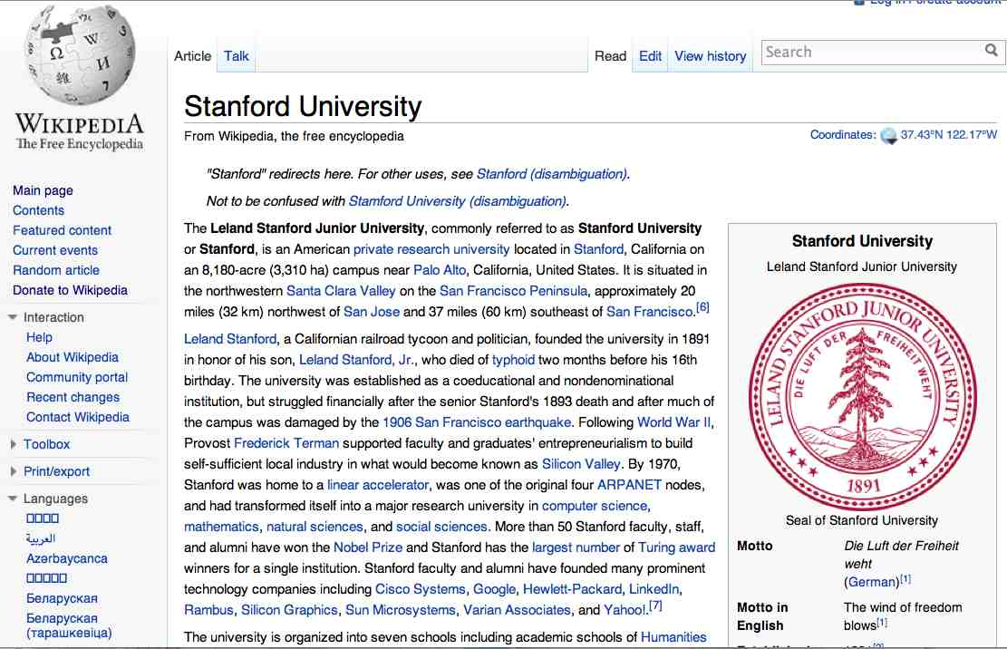
Extracting Relation Triples from Text
The Leland Stanford Junior University, commonly referred to as Stanford University or Stanford, is an American private research university located in Stanford, California … near Palo Alto, California… Leland Stanford…founded the university in 1891
Stanford EQ Leland Stanford Junior University
Stanford LOC-IN California
Stanford IS-A research university
Stanford LOC-NEAR Palo Alto
Stanford FOUNDED-IN 1891
Stanford FOUNDER Leland Stanford

Slide 4
Why Relation Extraction?
Create new structured knowledge bases, useful for any app
Augment current knowledge bases
  Adding words to WordNet thesaurus, facts to FreeBase or DBPedia
Support question answering
  The granddaughter of which actor starred in the movie “E.T.”?
  (acted-in ?x “E.T.”)(is-a ?y actor)(granddaughter-of ?x ?y)
But which relations should we extract?

Slide 5
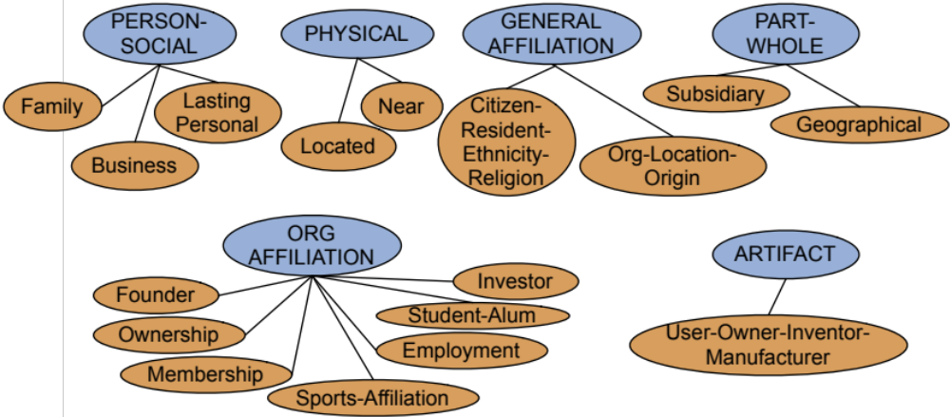
Automated Content Extraction (ACE)
17 relations from 2008 “Relation Extraction Task”

Slide 6
Automated Content Extraction (ACE)
Physical-Located PER-GPE
  He was in Tennessee
Part-Whole-Subsidiary ORG-ORG
  XYZ, the parent company of ABC
Person-Social-Family PER-PER
  John’s wife Yoko
Org-AFF-Founder PER-ORG
  Steve Jobs, co-founder of Apple…

Slide 7
UMLS: Unified Medical Language System
134 entity types, 54 relations
Injury disrupts Physiological Function
Bodily Location location-of Biologic Function
Anatomical Structure part-of Organism
Pharmacologic Substance causes Pathological Function
Pharmacologic Substance treats Pathologic Function

Slide 8
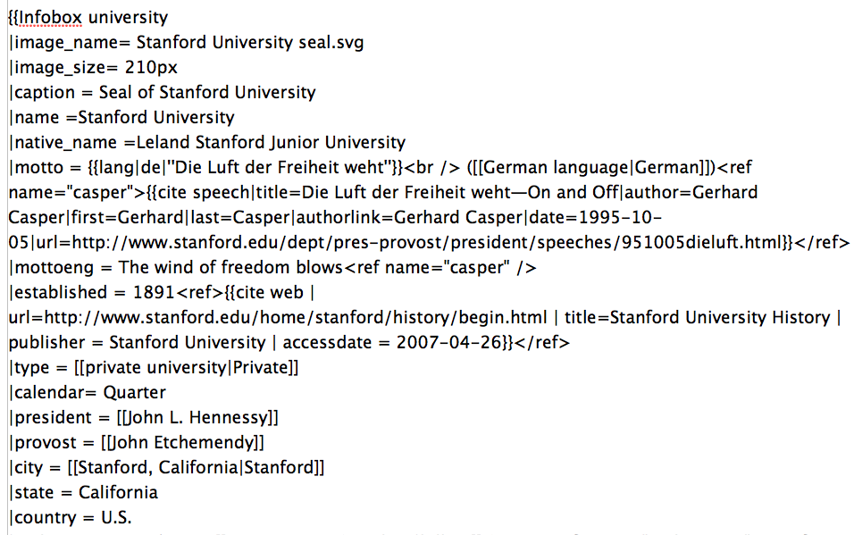
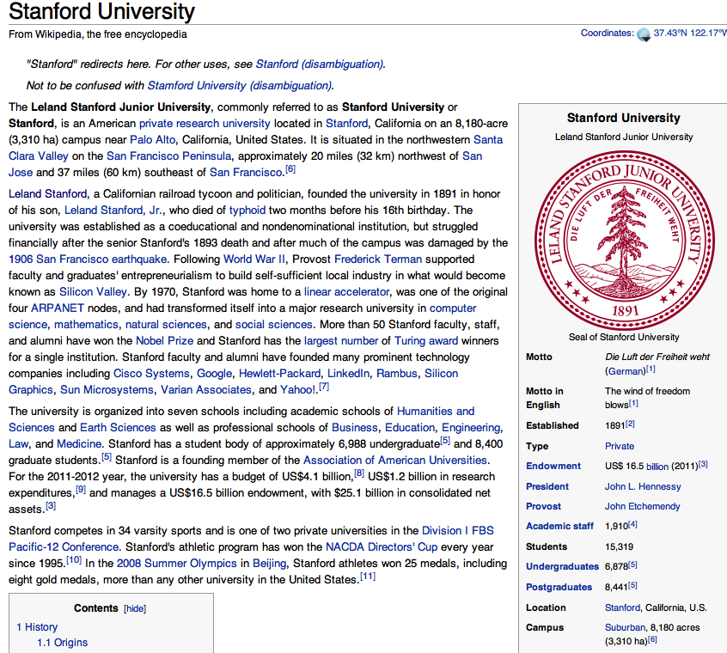
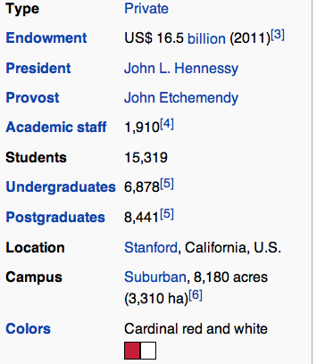
Databases of Wikipedia Relations
Wikipedia Infobox
Relations extracted from Infobox
Stanford state California
Stanford motto “Die Luft der Freiheit weht”
…

Slide 9
Relation databases that draw from Wikipedia
Resource Description Framework (RDF) triples
  subject predicate object
  Golden Gate Park location San Francisco
  dbpedia:Golden_Gate_Park dbpedia-owl:location dbpedia:San_Francisco
DBPedia: 1 billion RDF triples, 385 from English Wikipedia
Frequent Freebase relations:
    people/person/nationality, location/location/contains
    people/person/profession, people/person/place-of-birth
    biology/organism_higher_classification film/film/genre

Slide 10
Ontological relations
Examples from the WordNet Thesaurus
IS-A (hypernym): subsumption between classes
  Giraffe IS-A ruminant IS-A ungulate IS-A mammal IS-A vertebrate IS-A animal…
Instance-of: relation between individual and class
  San Francisco instance-of city

Slide 11
How to build relation extractors
Hand-written patterns
Supervised machine learning
Semi-supervised and unsupervised
  Bootstrapping (using seeds)
  Distant supervision
  Unsupervised learning from the web

Slide 12
Relation Extraction
What is relation extraction?

Slide 13
Relation Extraction
Using patterns to extract relations

Slide 14
Rules for extracting IS-A relation
Early intuition from Hearst (1992)
  “Agar is a substance prepared from a mixture of red algae, such as Gelidium, for laboratory or industrial use”
What does Gelidium mean?
How do you know?`

Slide 15
Rules for extracting IS-A relation
Early intuition from Hearst (1992)
  “Agar is a substance prepared from a mixture of red algae, such as Gelidium, for laboratory or industrial use”
What does Gelidium mean?
How do you know?`

Slide 16
Hearst’s Patterns for extracting IS-A relations
(Hearst, 1992): Automatic Acquisition of Hyponyms
“Y such as X ((, X)* (, and|or) X)”
“such Y as X”
“X or other Y”
“X and other Y”
“Y including X”
“Y, especially X”

Slide 17
Extracting Richer Relations Using Rules
Intuition: relations often hold between specific entities
  located-in (ORGANIZATION, LOCATION)
  founded (PERSON, ORGANIZATION)
  cures (DRUG, DISEASE)
Start with Named Entity tags to help extract relation!

Slide 18


Named Entities aren’t quite enough.
Which relations hold between 2 entities?
Cure?
Prevent?
Drug
Cause?
Disease
Notes:
Drug and disease pictures from Wikimedia Commons
http://commons.wikimedia.org/wiki/File:Gnome-face-sick.svg

Slide 19
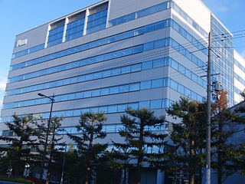

What relations hold between 2 entities?
Founder?
Investor?
Member?
PERSON
ORGANIZATION
Employee?
President?
Notes:
pictures from Wikimedia Commons
http://upload.wikimedia.org/wikipedia/commons/thumb/9/9a/Sanyo_Electric_Corporation.JPG/320px-Sanyo_Electric_Corporation.JPG

Slide 20
Extracting Richer Relations Using Rules and
Named Entities
Who holds what office in what organization?
  PERSON, POSITION of ORG
    George Marshall, Secretary of State of the United States
  PERSON(named|appointed|chose|etc.) PERSON Prep? POSITION
    Truman appointed Marshall Secretary of State
  PERSON [be]? (named|appointed|etc.) Prep? ORG POSITION
    George Marshall was named US Secretary of State

Slide 21
Hand-built patterns for relations
Plus:
  Human patterns tend to be high-precision
  Can be tailored to specific domains
Minus
  Human patterns are often low-recall
  A lot of work to think of all possible patterns!
  Don’t want to have to do this for every relation!
  We’d like better accuracy

Slide 22
Relation Extraction
Using patterns to extract relations

Slide 23
Relation Extraction
Supervised relation extraction

Slide 24
Supervised machine learning for relations
Choose a set of relations we’d like to extract
Choose a set of relevant named entities
Find and label data
  Choose a representative corpus
  Label the named entities in the corpus
  Hand-label the relations between these entities
  Break into training, development, and test
Train a classifier on the training set

Slide 25
How to do classification in supervised relation extraction
Find all pairs of named entities (usually in same sentence)
Decide if 2 entities are related
If yes, classify the relation
Why the extra step?
  Faster classification training by eliminating most pairs
  Can use distinct feature-sets appropriate for each task.

Slide 26
Automated Content Extraction (ACE)
17 sub-relations of 6 relations from 2008 “Relation Extraction Task”

Slide 27

Relation Extraction
Classify the relation between two entities in a sentence
American Airlines, a unit of AMR, immediately matched the move, spokesman Tim Wagner said.
EMPLOYMENT
FAMILY
NIL
CITIZEN
…
INVENTOR
SUBSIDIARY
FOUNDER

Slide 28
Word Features for Relation Extraction
American Airlines, a unit of AMR, immediately matched the move, spokesman Tim Wagner said
Mention 1
Mention 2
Headwords of M1 and M2, and combination
    Airlines Wagner Airlines-Wagner
Bag of words and bigrams in M1 and M2
{American, Airlines, Tim, Wagner, American Airlines, Tim Wagner}
Words or bigrams in particular positions left and right of M1/M2
    M2: -1 spokesman
    M2: +1 said
Bag of words or bigrams between the two entities
  {a, AMR, of, immediately, matched, move, spokesman, the, unit}

Slide 29
Named Entity Type and Mention Level
Features for Relation Extraction
American Airlines, a unit of AMR, immediately matched the move, spokesman Tim Wagner said
Mention 1
Mention 2
Named-entity types
  M1: ORG
  M2: PERSON
Concatenation of the two named-entity types
  ORG-PERSON
Entity Level of M1 and M2 (NAME, NOMINAL, PRONOUN)
  M1: NAME [it or he would be PRONOUN]
  M2: NAME [the company would be NOMINAL]

Slide 30
Parse Features for Relation Extraction
American Airlines, a unit of AMR, immediately matched the move, spokesman Tim Wagner said
Mention 1
Mention 2
Base syntactic chunk sequence from one to the other
  NP NP PP VP NP NP
Constituent path through the tree from one to the other
  NP ⬆ NP ⬆ S ⬆ S ⬇ NP
Dependency path
Airlines matched Wagner said

Slide 31
Gazeteer and trigger word features for relation extraction
Trigger list for family: kinship terms
  parent, wife, husband, grandparent, etc. [from WordNet]
Gazeteer:
  Lists of useful geo or geopolitical words
    Country name list
    Other sub-entities

Slide 32
Classifiers for supervised methods
Now you can use any classifier you like
  MaxEnt
  Naïve Bayes
  SVM
  ...
Train it on the training set, tune on the dev set, test on the test set

Slide 33
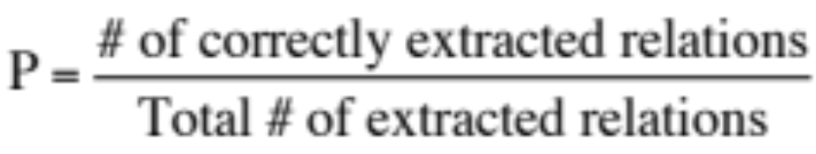
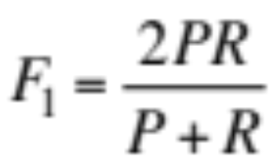
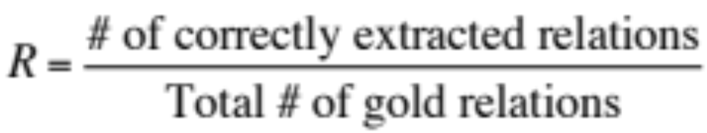
Evaluation of Supervised Relation Extraction
Compute P/R/F₁ for each relation

Slide 34
Summary: Supervised Relation Extraction
+ Can get high accuracies with enough hand-labeled training data, if test similar enough to training
- Labeling a large training set is expensive
- Supervised models are brittle, don’t generalize well to different genres

Slide 35
Relation Extraction
Supervised relation extraction

Slide 36
Relation Extraction
Semi-supervised and unsupervised relation extraction

Slide 37
Seed-based or bootstrapping approaches to relation extraction
No training set? Maybe you have:
  A few seed tuples or
  A few high-precision patterns
Can you use those seeds to do something useful?
  Bootstrapping: use the seeds to directly learn to populate a relation

Slide 38
Relation Bootstrapping (Hearst 1992)
Gather a set of seed pairs that have relation R
Iterate:
  Find sentences with these pairs
  Look at the context between or around the pair and generalize the context to create patterns
  Use the patterns for grep for more pairs

Slide 39
Bootstrapping
<Mark Twain, Elmira> Seed tuple
  Grep (google) for the environments of the seed tuple
  “Mark Twain is buried in Elmira, NY.”
    X is buried in Y
  “The grave of Mark Twain is in Elmira”
    The grave of X is in Y
  “Elmira is Mark Twain’s final resting place”
    Y is X’s final resting place.
Use those patterns to grep for new tuples
Iterate

Slide 40
Dipre: Extract <author,book> pairs
Brin, Sergei. 1998. Extracting Patterns and Relations from the World Wide Web.
Start with 5 seeds:
Find Instances:
  The Comedy of Errors, by William Shakespeare, was
  The Comedy of Errors, by William Shakespeare, is
  The Comedy of Errors, one of William Shakespeare's earliest attempts
  The Comedy of Errors, one of William Shakespeare's most
Extract patterns (group by middle, take longest common prefix/suffix)
  ?x , by ?y , ?x , one of ?y ‘s
Now iterate, finding new seeds that match the pattern
Author | Book
Isaac Asimov | The Robots of Dawn
David Brin | Startide Rising
James Gleick | Chaos: Making a New Science
Charles Dickens | Great Expectations
William Shakespeare | The Comedy of Errors

Slide 41
Snowball
E. Agichtein and L. Gravano 2000. Snowball: Extracting Relations
from Large Plain-Text Collections. ICDL
Similar iterative algorithm
Group instances w/similar prefix, middle, suffix, extract patterns
  But require that X and Y be named entities
  And compute a confidence for each pattern
Organization | Location of Headquarters
Microsoft | Redmond
Exxon | Irving
IBM | Armonk
.69
ORGANIZATION
{’s, in, headquarters}
LOCATION
.75
LOCATION
{in, based}
ORGANIZATION

Slide 42
Unsupervised relation extraction
M. Banko, M. Cararella, S. Soderland, M. Broadhead, and O. Etzioni. 2007. Open information extraction from the web. IJCAI
Open Information Extraction:
  extract relations from the web with no training data, no list of relations
Use parsed data to train a “trustworthy tuple” classifier
Single-pass extract all relations between NPs, keep if trustworthy
Assessor ranks relations based on text redundancy
    (FCI, specializes in, software development)
    (Tesla, invented, coil transformer)

Slide 43
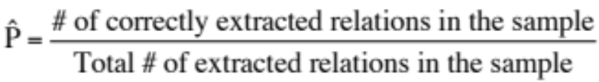
Evaluation of Semi-supervised and
Unsupervised Relation Extraction
Since it extracts totally new relations from the web
  There is no gold set of correct instances of relations!
    Can’t compute precision (don’t know which ones are correct)
    Can’t compute recall (don’t know which ones were missed)
Instead, we can approximate precision (only)
  Draw a random sample of relations from output, check precision manually
Can also compute precision at different levels of recall.
  Precision for top 1000 new relations, top 10,000 new relations, top 100,000
  In each case taking a random sample of that set
But no way to evaluate recall

Slide 44
Relation Extraction
Semi-supervised and unsupervised relation extraction

